Slide 1
Types of modelling tools
Draw on macroeconomic relationships and cross-sectoral dependencies.
MODELLING TOOLS
TOP-DOWN
ECONOMETRIC
INPUT/OUTPUT
CGE
BOTTOM-UP
ACCOUNTING
SIMULATION
OPTIMISATION
HYBRID MODELS
statistical analysis of historical time-series
interrelations between various sub-sectors of the economy
economy wide general equilibrium between sectoral demands and supplies
Projections based on socio-economic, technology and demographics
Accounting + rules (for dispatch, investments, …)
Calculate energy systems attributes driven by an objective function.
Provide a more detailed technological representation of the system.
Resource – to –use representation.
Mix of two or more of the above.

Slide 2
Optimisation models
Study of decision problems in which one seeks to minimise or maximise a function by systematically choosing the values of variables within their allowed sets.
Basic variables
Decision: describe alternative courses of action and are determined by decision makers (e.g. investments in new power plants);
Parameters: factors that affect the results. They are determined by the elements of the system and can be called “constraints of the problem” if they limit decision makers (e.g. O&M costs, emission caps, max capacity additions, fuel reserves).
Result: represent model outputs; they are frequently described by objective functions, such as profit (max) and cost (min or least-cost).

Slide 3
Characteristics of optimisation models
Common (but not exclusive!) characteristics:
Perfect competition: all players in the market compete against each other and supply their electricity at their marginal cost (”price takers”);
Perfect information: the market players make decisions with perfect information about parameters influencing them (e.g. all costs of all power plants known);
Perfect foresight: sub-set of the above; market players are assumed to know everything that will happen in the future (e.g. how demand evolves);
Dynamic: it gives solutions for different points in time (i.e. not only a snapshot);
Economically-rational consumer behaviour: technologies with the cheapest life-cycle costs are invested in.

Slide 4
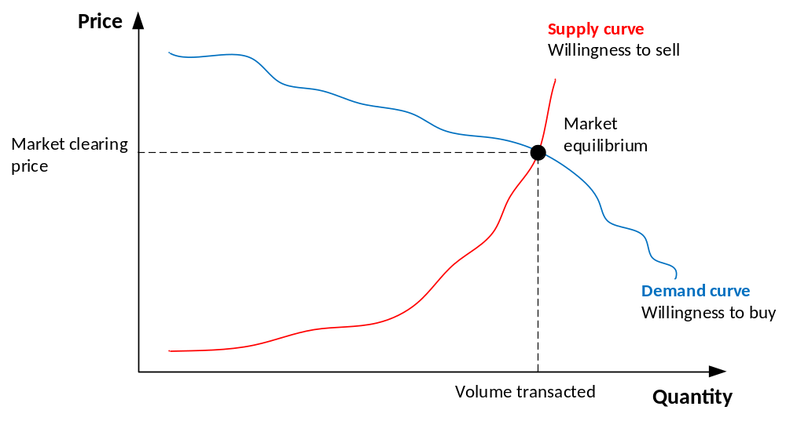
Characteristics of optimisation models
One category is Partial Equilibrium models: they calculate the economic equilibrium of supply and demand within the sector being modelled (e.g. energy and power sectors).

Slide 5
Types of optimisation models
Linear programming (LP)
  Type of optimisation in which the objective function and constraints are all linear. It is the base of other optimisation models. Mixed-Integer Linear Programming (MILP) is a subset.
Nonlinear programming (NLP)
  Similar to LP, but where some of the constraints and/or the objective function are nonlinear.
Multi-objective programming (MOP)
  Process in which two or more conflicting objectives are optimised subject to certain constraints.
Bi-level programming (BLP) and multi-level programming (MLP)
  Complex optimisation problems where one problem is embedded in another one (a BLP is a two-level MLP).

Slide 6
Why using linear optimisation models in energy systems analysis?
to identify least-cost energy systems
to identify cost-effective responses to restrictions on emissions
to perform prospective analysis of long-term energy balances under different scenarios
to evaluate new technologies and priorities for R&D
to evaluate the effects of regulations, taxes, and subsidies
to project inventories of greenhouse gas emissions
to estimate the value of regional cooperation
Investigate scenarios (possible futures);
Explore alternatives to business as usual practices;
Inform decisions (policy and strategic planning)

